Slide 1
Update to results, 6-25-20

Slide 2
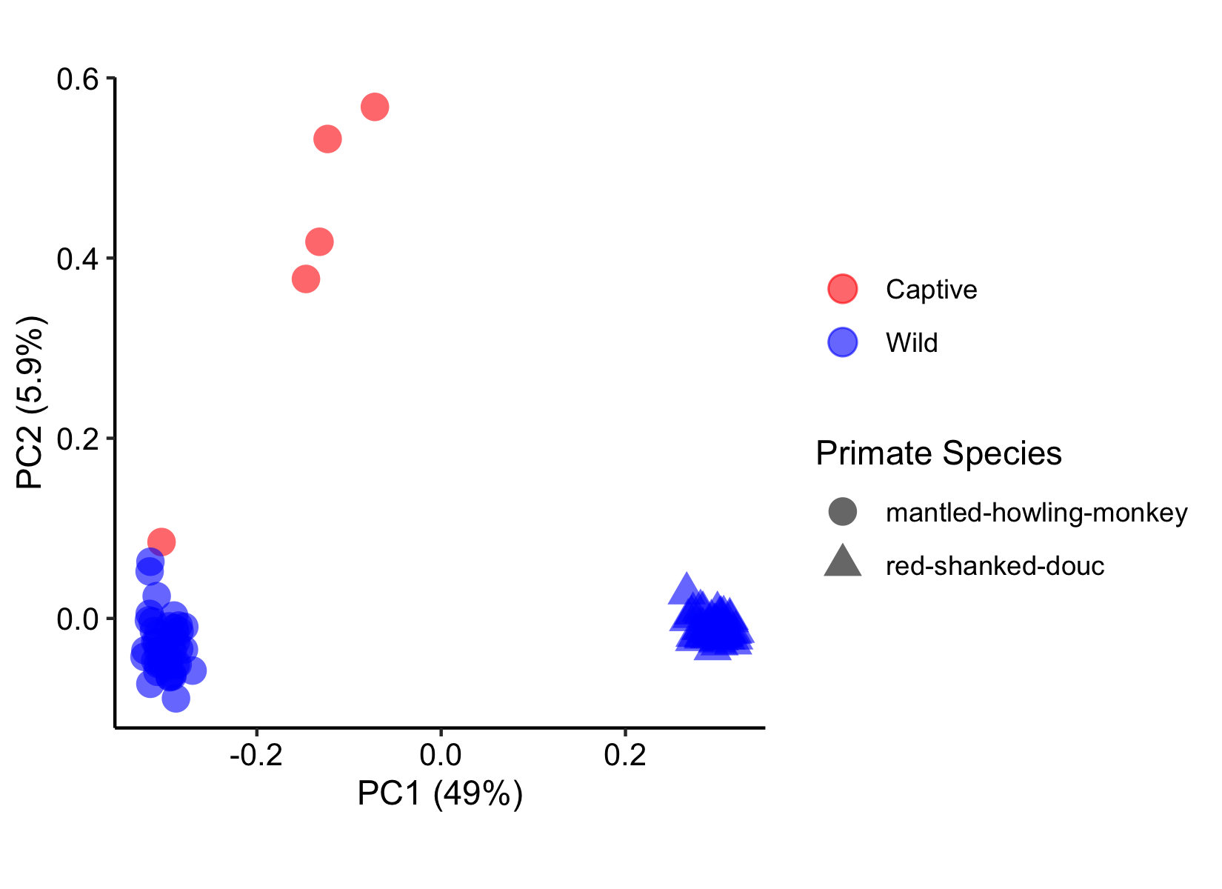
“Were you able to test if there is any correlation between parasite load and/or parasite type on beta diversity matrices in R?”
Overall PCoA plot, for reference. Cannot really test within this because of the dramatic differences between the two primates.
See next slide for comparisons within a species (answers next questions).
With regard to parasite type, Doucs pretty much just had Trichuris, so essentially parasite positive = trichuris, negative = none (only a few exceptions there)
In howlers, it’s all pretty mixed together, frankly.

Slide 3
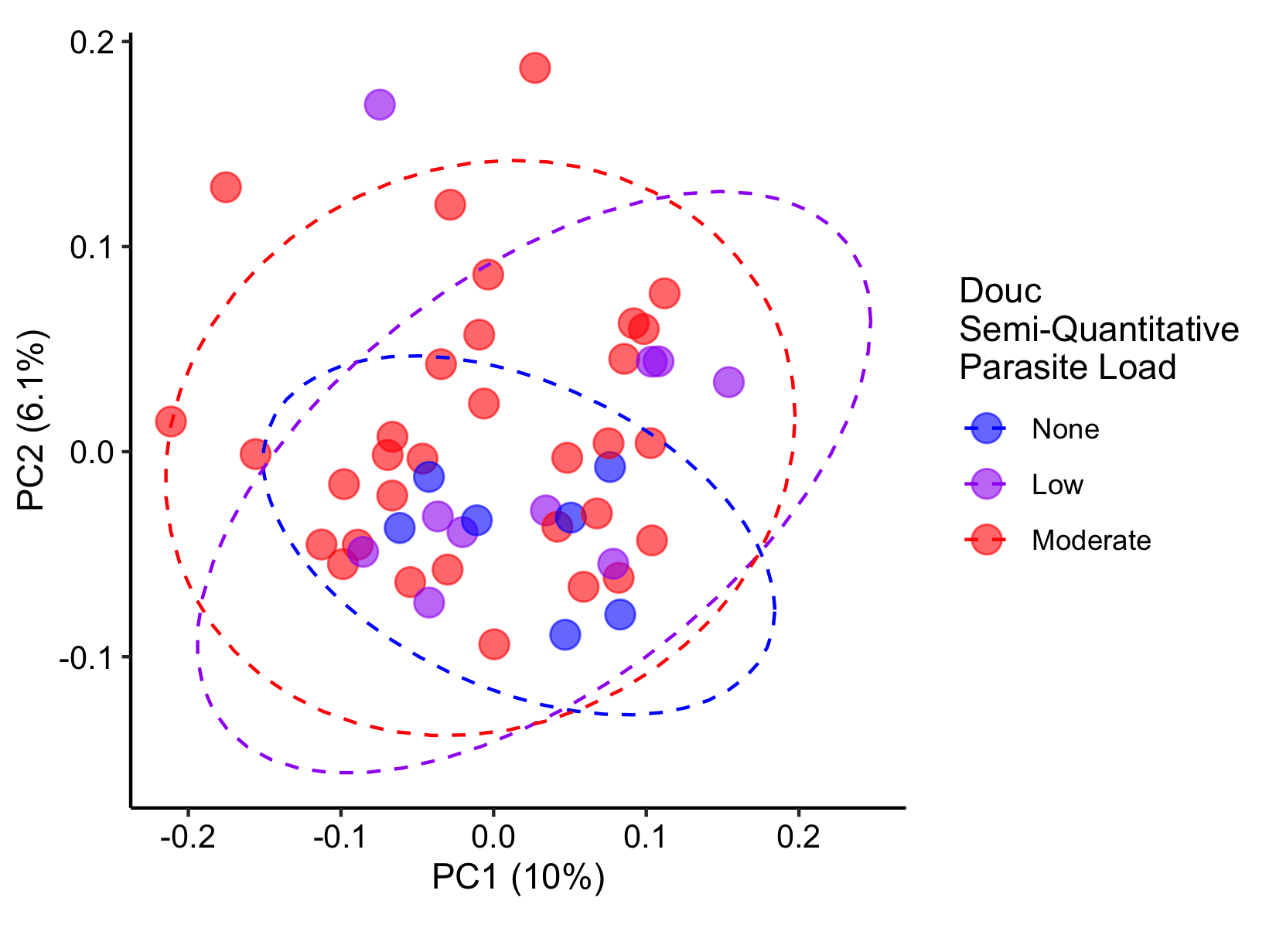
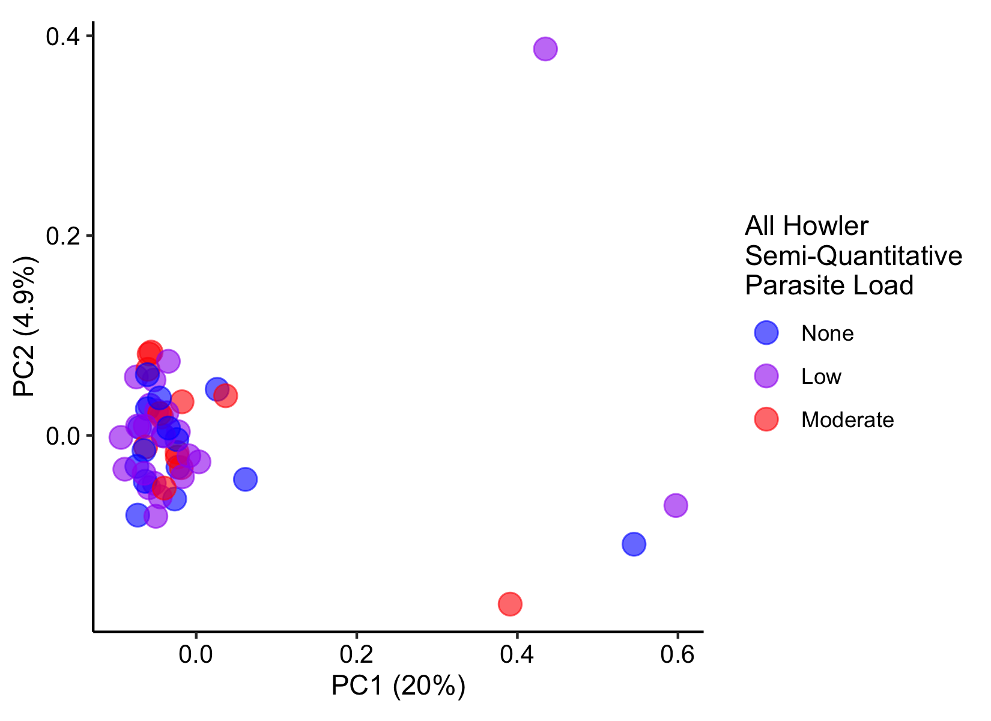
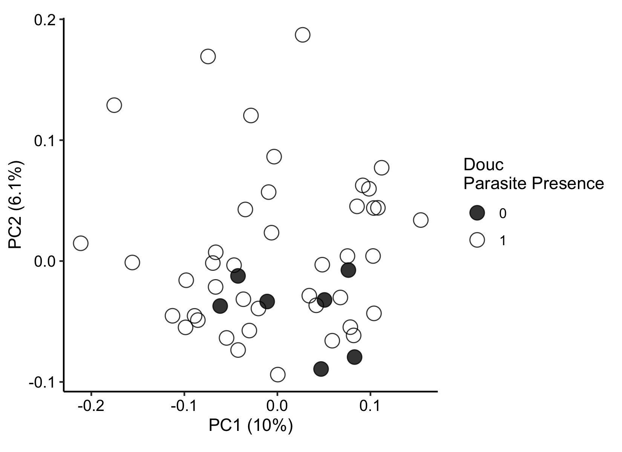
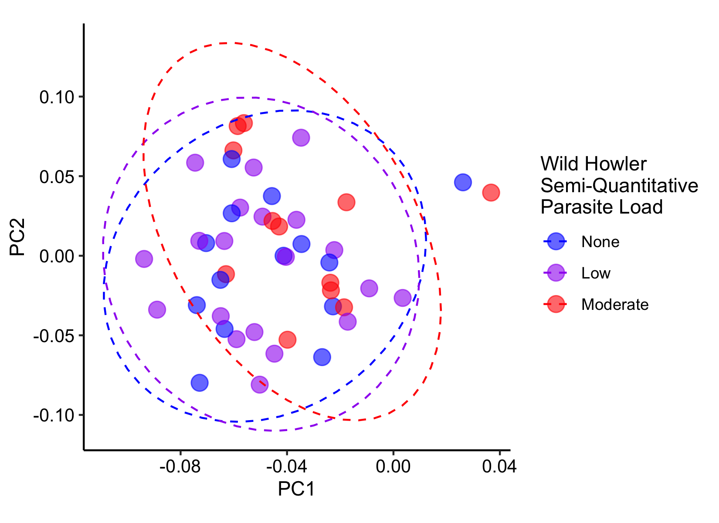
“Within species, do individuals cluster by infection status in the PCoA plots?”
There is some clustering of the no-parasite samples in the Doucs (left), but not in the Howlers. This isn’t strong enough to be significant by Adonis (p=0.3), but the groups are also much different sizes.

Slide 4
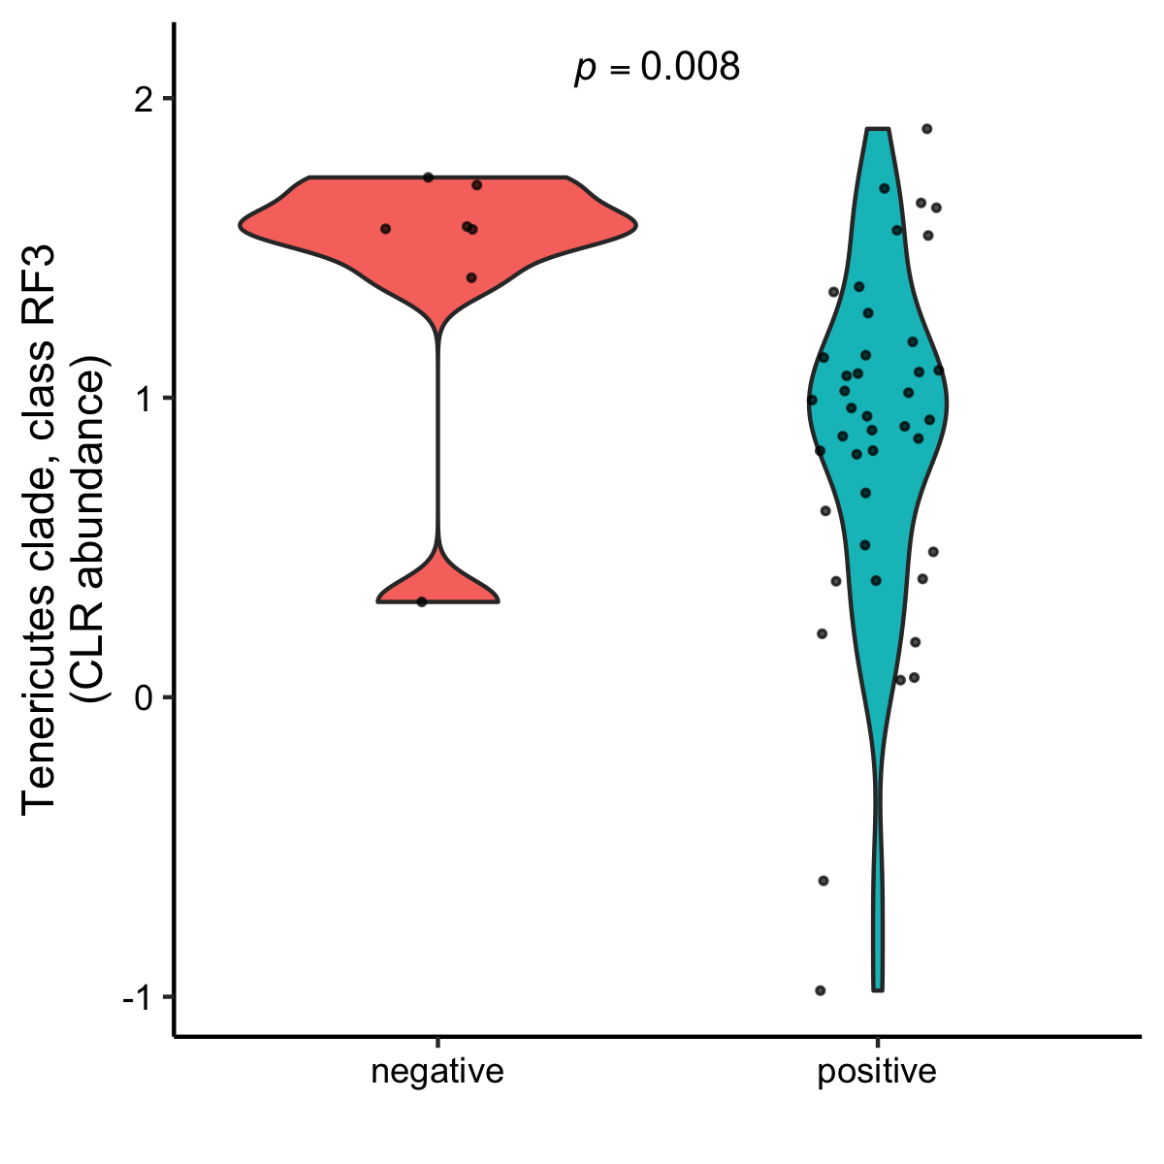
“For alpha diversity, it looks like certain taxa vary with infection in the howlers. However, I was not sure if these were changes related to specific parasite loads (none, low, moderate) or across infection generally.”
I used a Feature Selection approach (Boruta selection, uses random forest machine learning) to test whether taxa at Order, Family, or Genus level are predictive of parasite load – semiquantitative or presence/absence. There aren’t any significant predictors using this method. The number of Howlers with no parasites is small relative to positives.
I did a similar thing with Doucs though, and chased some rough annotations back to the Class level and an association with a Tenericutes class (see right)
https://schaechter.asmblog.org/schaechter/2018/02/a-whiff-of-taxonomy-the-tenericutes.html
https://pubmed.ncbi.nlm.nih.gov/27058507/
GreenGenes annotated this one to RF3 clade of Tenericutes

Slide 5
Previous analysis plots (dated 8/23/2019)

Slide 6
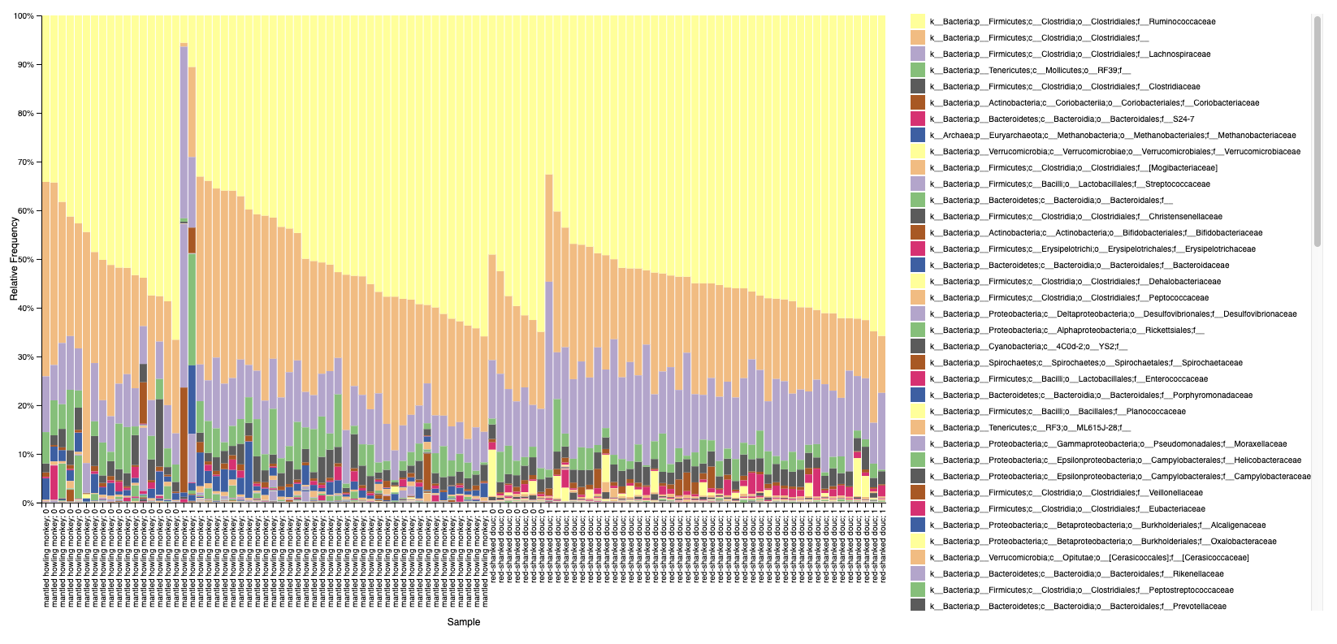
Monkey species : presence(1)/absence(0) parasites by microscopy

Slide 7
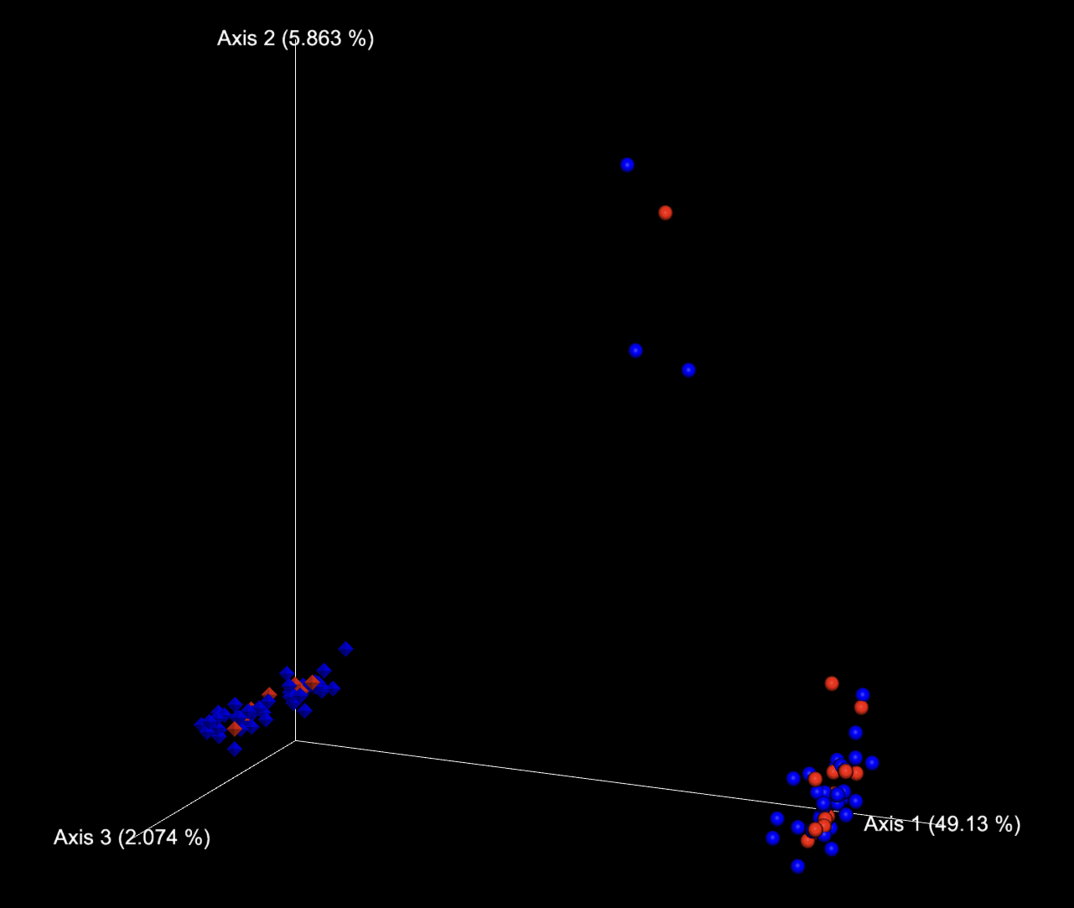
Captive howlers
Unweighted Unifrac
Blue = parasite positive
Red = no parasite
Diamond = douc
Sphere = howler
Wild howlers, except the very top one (recent captive)

Slide 8
Faith’s PD
Shannon

Slide 9
howlers
Faith’s PD vs parasite presence
Shannon vs parasite presence

Slide 10
doucs
Faith’s PD vs parasite presence
Shannon vs parasite presence

